Slide 1

Digital Transformation in Education
Improving student outcomes with Predictive Analytics
TDM Deck

Slide 2

Improving Student outcomes – A Recap

Slide 3

Today’s statistics should have no place in our children‘s tomorrows
1.2 million
$200,000
students drop out of high school in the US
average lifetime earnings unrealized without high school diploma
40%
75%
of students fail to graduate on time
of crimes in the US
committed by dropouts

Slide 4



US University Dropouts
40% of students seeking bachelor’s degrees do not complete their degree within 6 years
30% of ﬁrst-year students at US baccalaureate institutions do not return for their second year
First year attrition of particular importance, US $9 Billion annually on 30% full time first-year students

Slide 5

Imagine if you could improve the performance of all students

Slide 6
Student Dropout Predictive Analytics Solution

Slide 7
Scenario #1: Student Lifecycle and Success Management
Objective
Scenario | Student Performance Analysis
Description | End-to-end life cycle tracking with available student information to facilitate predictive analytics
Target Outcome | Prevent student drop-outs

Slide 8
Universities can prepare students with Predictive Analytics
Connect and ingest data from different data silo’s
Build reporting systems that identify and predict student performance
Manage performance and measure success “continuously”

Slide 9
Big Data + Predictive Analytics = Business Value
Data
What should I do?
Decision
Action
Automation
Recommendation
What might happen?
(Predictive Models)
Why did it happen?
{Interactive Dashboards)
What happened?
(Reports)
People & Insights

Slide 10
Azure – Built for Enterprise scale
Enterprise-grade
A trusted cloud – 57% of Fortune 500 companies rely on Azure
A recognized Leader in Gartner Magic Quadrants
Industry-leading commitments to data protection, security measures, privacy policies, and international compliance programs
Hyper-scale
Runs your apps anywhere across 20+ regions
Provides an open and flexible platform from operating systems to coding languages
Delivers scale-as-you-need, pay-as-you-go models via Azure’s near infinite capacity
Hybrid
Extends your existing capabilities
Enables workloads to transition easily across customer sites, service provider datacenters and Azure
Empowers customers to deploy tiered workloads across environments, truly achieving the best of both clouds

Slide 11
Intelligent solutions with Azure
Information Management and data ingestion
Big Data Stores
Machine Learning and Analytics
Intelligence
Data Sources
People
Cognitive Services
Data Factory
Data Lake Store
Machine Learning
Bot Framework
Web
Apps
Data Catalog
SQL Data
Warehouse
Data Lake Analytics
Cortana
Mobile
HDInsight
(Hadoop and Spark)
Apps
Event Hubs
Azure SQL Database
Bots
Dashboards & Visualizations
Stream Analytics
Sensors and devices
Power BI
Automated Systems
Data
Intelligence
Action

Slide 12
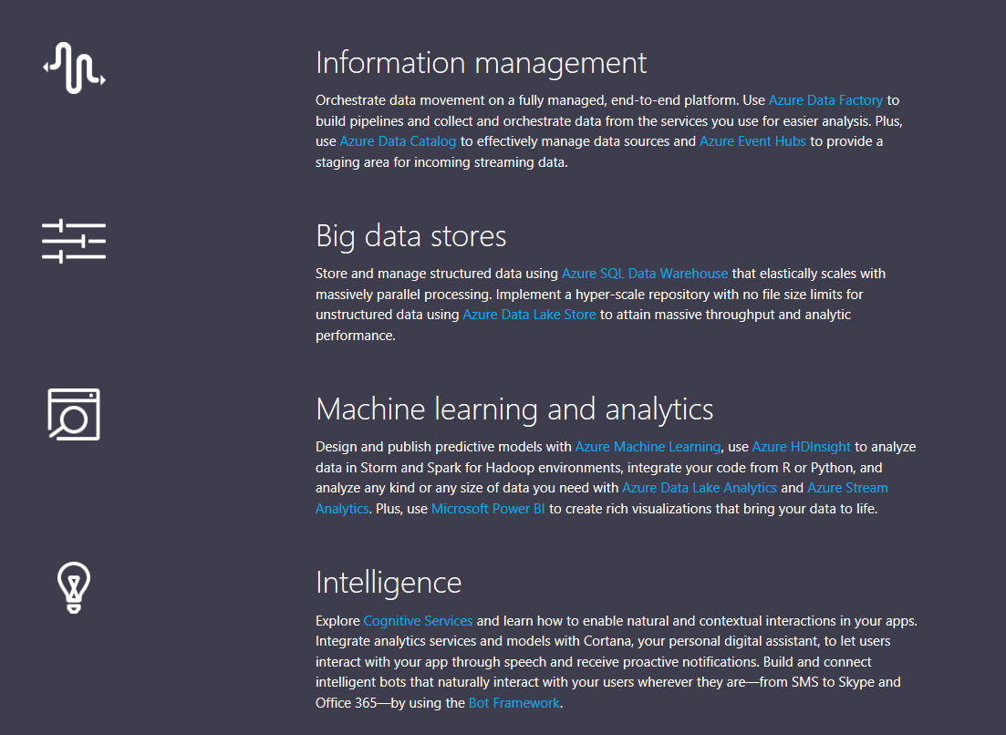
Big Data + Predictive Analytics = Business Value

Slide 13








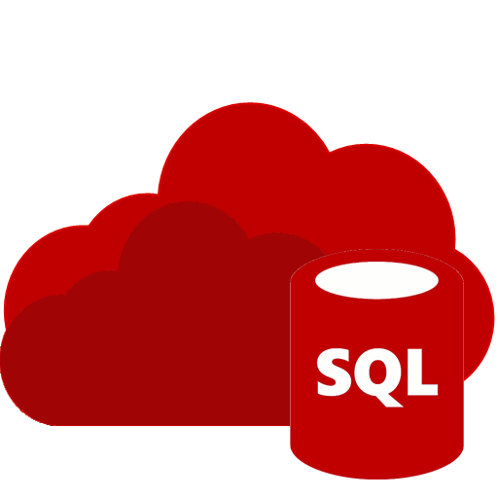








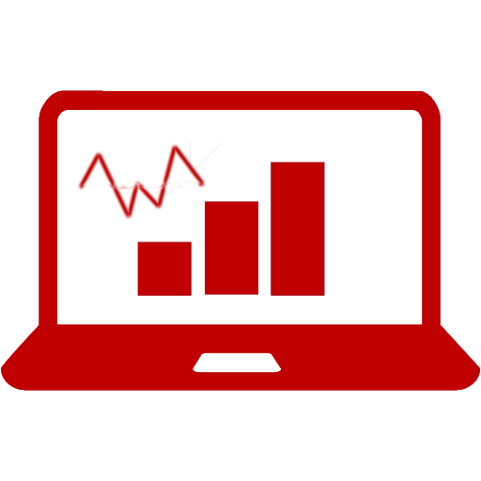




Reference Architecture
Reference Architecture
Two-Class Bayes Point Machine
99.9%
On-Premises
SLA
MACHINE LEARNING
STORAGE
(Blob)
ANALYSIS
(HDInsight)
STORAGE
(SQL Database)
DATA CONSUMPTION
Data
Management
Gateway
DATA SOURCES
Data Factory Movement Service

Slide 14
Student Dropout Predictive Modeling with Azure ML

Slide 15

Connect and ingest data from different data silo’s
Solution Components:
Azure Data Factory
Azure SQL DB

Slide 16
Leverage cost-effective and feature-rich data integration and aggregation services
Ingest data from different SIS, LMS sources from on-premise
Anonymize student data if required
Build early prevention activities for at-risk students
Determine which concepts a student has mastered and which concepts they struggle with
Develop courses and interventions that are most likely to be successful with particular students
Connect and ingest data from different data silo’s
student performance

Slide 17
Build reporting systems that identify and predict student performance
Solution Components:
Azure Data Factory
Azure Machine Learning Studio
Azure SQL Database

Slide 18
Leverage cost-effective and feature-rich analytics services with powerful self-service capabilities
View grades, assessment scores, and attendance
Anticipate students likely to struggle in various academic areas
Predict dropout profiles and those unlikely to meet academic excellence indicators
Determine which concepts a student has mastered and which concepts they struggle with
Scale up to more advanced scenarios
Build reporting systems that identify and predict student performance

Slide 19
Manage performance and measure success
Solution Components:
Azure Data Factory
Azure SQL DB
Power BI dashboards

Slide 20
Keep track of students’ progress with continuously monitoring
Determine which concepts a student has mastered and which they struggle with
Counselors can use this data in one-on-one discussions and agree on goals for improvement
Build early prevention activities for at-risk students
Provide counseling to students based on projections
Manage performance and measure success

Slide 21
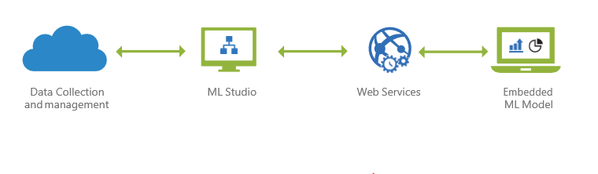
Predictive Modeling with Azure ML
Azure Machine Learning (Azure ML) is a cloud predictive analytics service that makes it possible to quickly create and deploy predictive models as analytics solutions.
You can work from a ready-to-use library of algorithms, use them to create models on an internet-connected PC, and deploy your predictive solution quickly. Start from ready-to-use examples and solutions in the Cortana Intelligence Gallery.

Slide 22
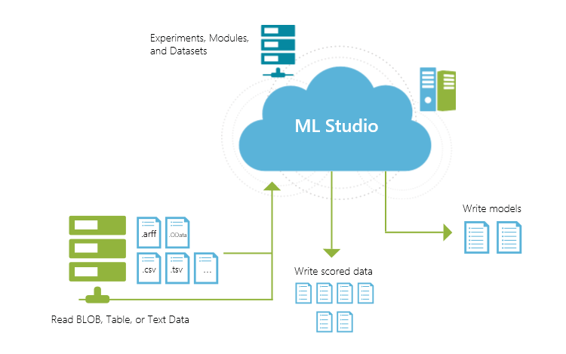
Predictive Modeling with Azure ML
Azure ML studio also offers several standard templates.
A machine learning template demonstrates common building blocks in building a machine learning solution, starting from data preparation, data processing, feature engineering, model training to model deployment.
The goal of the templates is to enable data scientists to quickly build and deploy custom machine learning solutions with Azure Machine Learning platform, and increase their productivity.

Slide 23

Closing

Slide 24
Get started
Start by getting Office 365 for Education for your school:
https://www.microsoft.com/en-us/education/products/office/default.aspx

